Slide 1

Rockbuster STEALTH- Online Video Streaming Launch strategy
Shanta Maraj June 2025

Slide 2
Table of contents
Introduction Key Questions Rockbuster Data Overview Film Gross Comparison Film Performance Insights & Recommendations Category Performance Category Performance Insights & Recommendations Film Rating & Revenue Rental Behavior Global Reach Regional Comparison Revenue Per Genre in Top Ten Countries Top Genres Insights & Recommendations Customer Loyalty Launch Strategy Outline For Rockbuster Online Video Streaming Platform Launch Strategy For Rockbuster Online Video Streaming Platform

Slide 3
Introduction
Rockbuster Stealth LLC is a movie rental company that used to have stores around the world. The management team is planning to use its existing movie licenses to launch an online video rental service to stay competitive with other streaming giants such as Netflix and Amazon Prime.
Objective: Use data insights to develop a launch strategy for an online video rental platform that leverages Rockbuster's extensive movie licenses in 108 countries to offer a diverse content library and personalized user experience.

Slide 4
Key questions
Which movies contributed the most/least to revenue gain?
What was the average rental duration for all videos?
Do sales figures vary between geographic regions?
Which countries are Rockbuster customers based in?
Where are customers with a high lifetime value based?

Slide 5
Rockbuster DATA Overview
1000 films
4581 movie inventory
108 countries
599 customers
16044 movie rentals
5 mpaa rating categories
20 genres
5 days (average rental duration)
$2.98 (average rental rate)
$19.99 (average replacement cost)

Slide 6
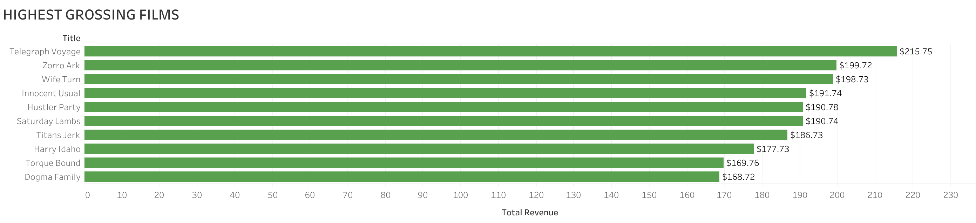
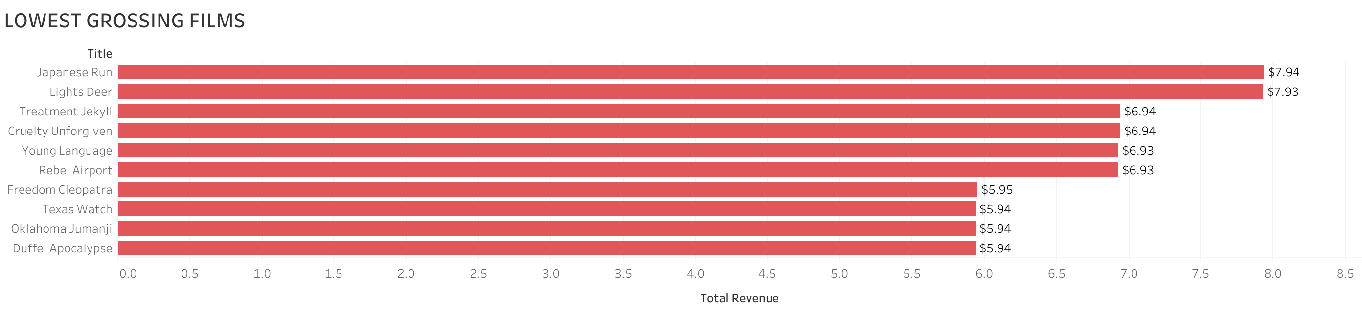
Film gross comparison

Slide 7
Film GROSS Comparison
1. Which movies contributed the most/least to revenue gain?
Top Grossing Movies | Individual Movie Revenue
Telegraph Voyage | $215.75
Zorro Ark | $199.72
Wife Turn | $198.73
Innocent Usual | $191.74
Hustler Party | $190.78
Saturday Lambs | $190.74
Titans Jerk | $186.73
Harry Idaho | $177.73
Torque Bound | $169.76
Dogma Family | $168.72
Bottom Grossing Movies | Individual Movie Revenue
Oklahoma Jumanji | $5.94
Duffel Apocalypse | $5.94
Texas Watch | $5.94
Freedom Cleopatra | $5.95
Young Language | $6.93
Rebel Airport | $6.93
Treatment Jekyll | $6.94
Cruelty Unforgiven | $6.94
Lights Deer | $7.93
Japanese Run | $7.94

Slide 8
FILM Performance Insights & Recommendations
Key Insights
Total Revenue: $61,312.04 Top 10 Movies Contribution: 3.8% of total revenue = $1890.40 Bottom 10 Movies Contribution 1.1% of total revenue = $67.38
Since the top 10 movies account for a small portion of total revenue, increasing the performance of mid-tier movies could significantly boost overall revenue.
The low contribution of the bottom movies suggests that efforts to either improve or phase out low-performing titles could improve revenue. Recommendations
1. Focus on top performing movies- invest in marketing these movies to maximize their revenue potential.
2. Improve mid-tier films- Identify the characteristics of the middle performing movies to replicate their success.
3. Do a further analysis on low performing movies- analyze why certain movies underperform and consider whether to re-market or remove from inventory.

Slide 9
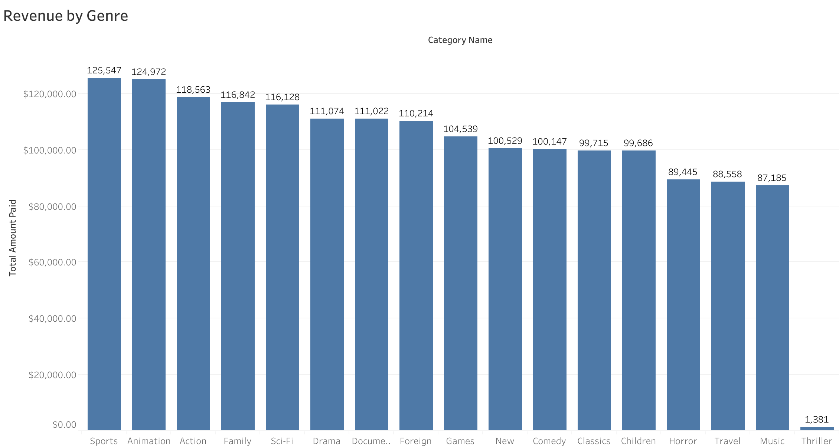
Category Performance

Slide 10
Category Performance Insights & Recommendations
Key Insights
The top 5 revenue-generating categories—Sports, Animation, Action, Family, and Sci-Fi
A broad middle tier includes genres like Drama, Documentary, Foreign, Games, New, Comedy, Classics, Children, Horror, Travel, and Music
Thriller movies only grossed $1,381, with further investigation revealing that Rockbuster has only one film in this category, limiting revenue potential.
No revenue was recorded from Crime, Romance, and War genres, indicating a lack of content investment or audience engagement in these areas.
Recommendations
Focus on expanding successful genres like Sports, Animation, Action, and Family to maximize revenue.
Add more Thriller movies to inventory to increase revenue in this category
Investigate why Crime, Romance and War movies are not generating revenue and then decide whether to develop or remove these categories from inventory

Slide 11
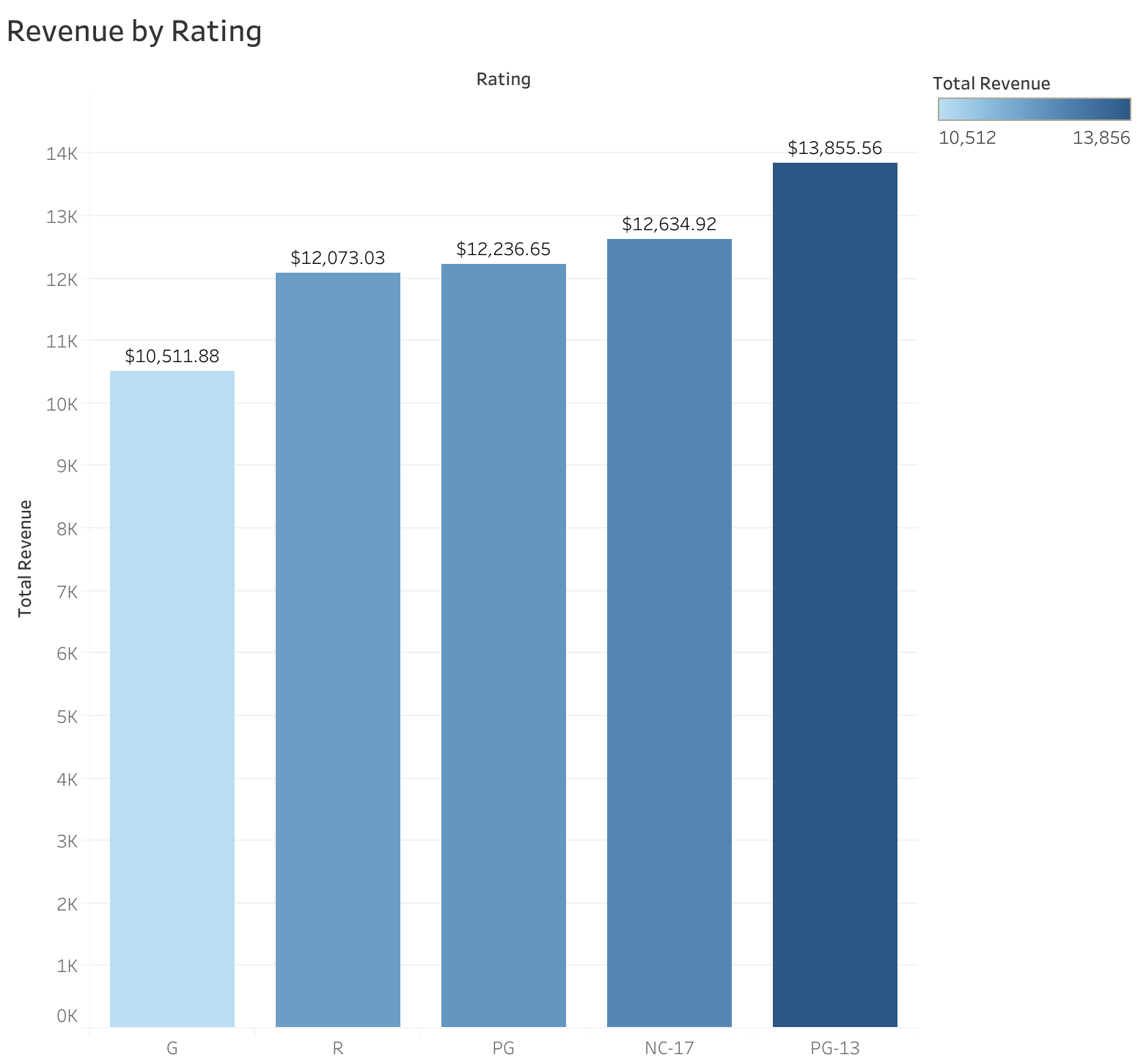
Film rating & Revenue
Key Insights
Revenue from all 5 rating groups are high varying between $10k-$14k.
PG-13 films generated the most revenue suggesting a strong audience for this rating.
Recommendations
Focus on marketing PG-13 & NC-17 movies more to attract larger audiences and increase profits
Further analyze G and R- rated films. Are they fewer in inventory number or less promoted?

Slide 12
Rental Behavior
2. What was the average rental duration for all videos?
Minimum Rental Duration: 3 days Maximum Rental Duration: 7 days Average Rental Duration: 5 days Minimum Rental Rate: $0.99 Maximum Rental Rate: $4.99 Average Rental Rate: $2.98

Slide 13
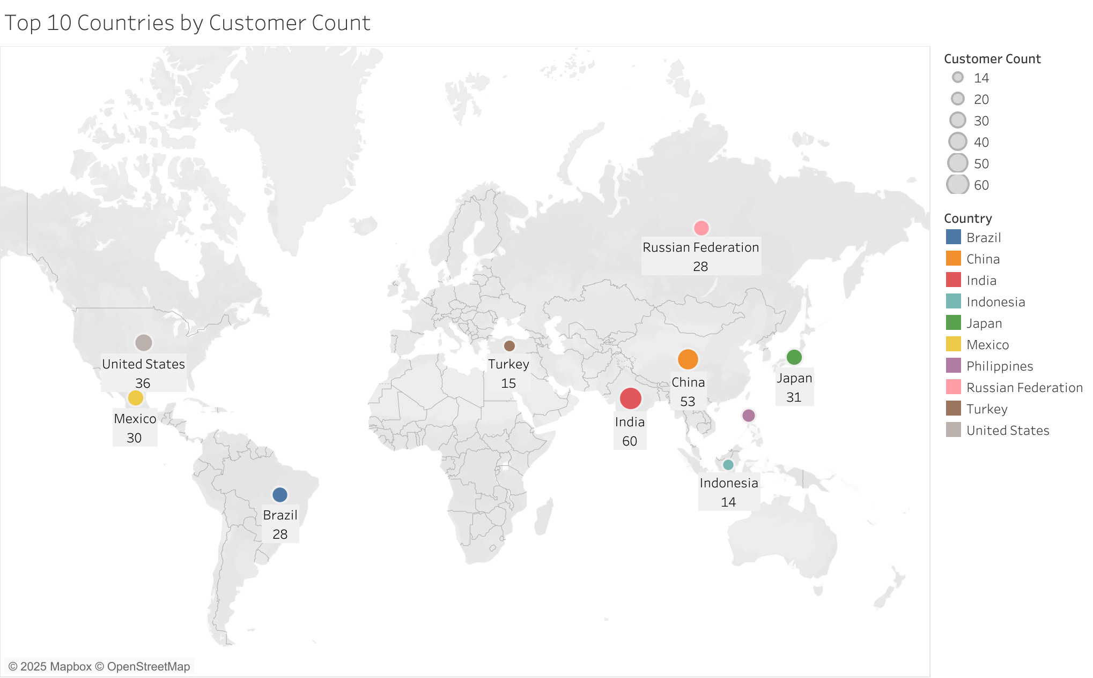
Global Reach
3. Which countries are Rockbuster customers based in?
Rockbuster’s customers are spread out among 108 countries across the globe
Countries With Largest Customer Base:
India 60 China 53
United States 36
Japan 31
Mexico 30
Brazil 28
Russian Federation 28
Philippines 20
Turkey 15
Indonesia 14

Slide 14
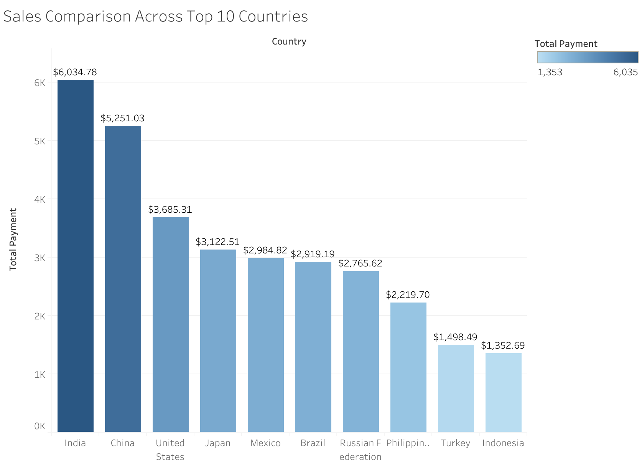
Regional Comparison
4. Do sales figures vary by regions?
Key Insights
Total Revenue: $61,312.04 Revenue Top 10 Countries: $31,834.14 Revenue Other Countries: $29,477.90
Countries have between 1 and 60 customers. And there is a positive correlation between the number of customers in a country and the amount of revenue from that country (The 10 countries with the most customers are also the 10 countries with the highest total revenue)
There is a significant disparity between the number of customers and the revenue generated across countries. Despite Rockbuster having a large global presence in 108 countries, 52% of total revenue comes from the top 10 countries suggesting a large revenue concentration in a small subset of countries

Slide 15
Regional Comparison
4. Do sales figures vary by regions?
Country | Number of Customers | Total Revenue
India | 60 | $6034.78
China | 53 | $5251.03
United States | 36 | $3685.31
Japan | 31 | $3122.51
Mexico | 30 | $2984.82
Brazil | 28 | $2919.19
Russian Federation | 28 | $2765.62
Philippines | 20 | $2219.70
Turkey | 15 | $1498.49
Indonesia | 14 | $1352.69
India is Rockbuster's most lucrative market with 60 customers grossing over $6000
Indonesia is 10th on the list with 14 customers and grossing a little over $1300
American-Samoa sits at the bottom of the list (108) bringing in the least amount of revenue by country ($48)
YES- SALES FIGURES VARY GREATLY ACROSS REGIONS. The key gap is the imbalance between the number of customers and the revenue contribution across countries. The majority of Rockbuster's revenue comes from a small number of countries.

Slide 16
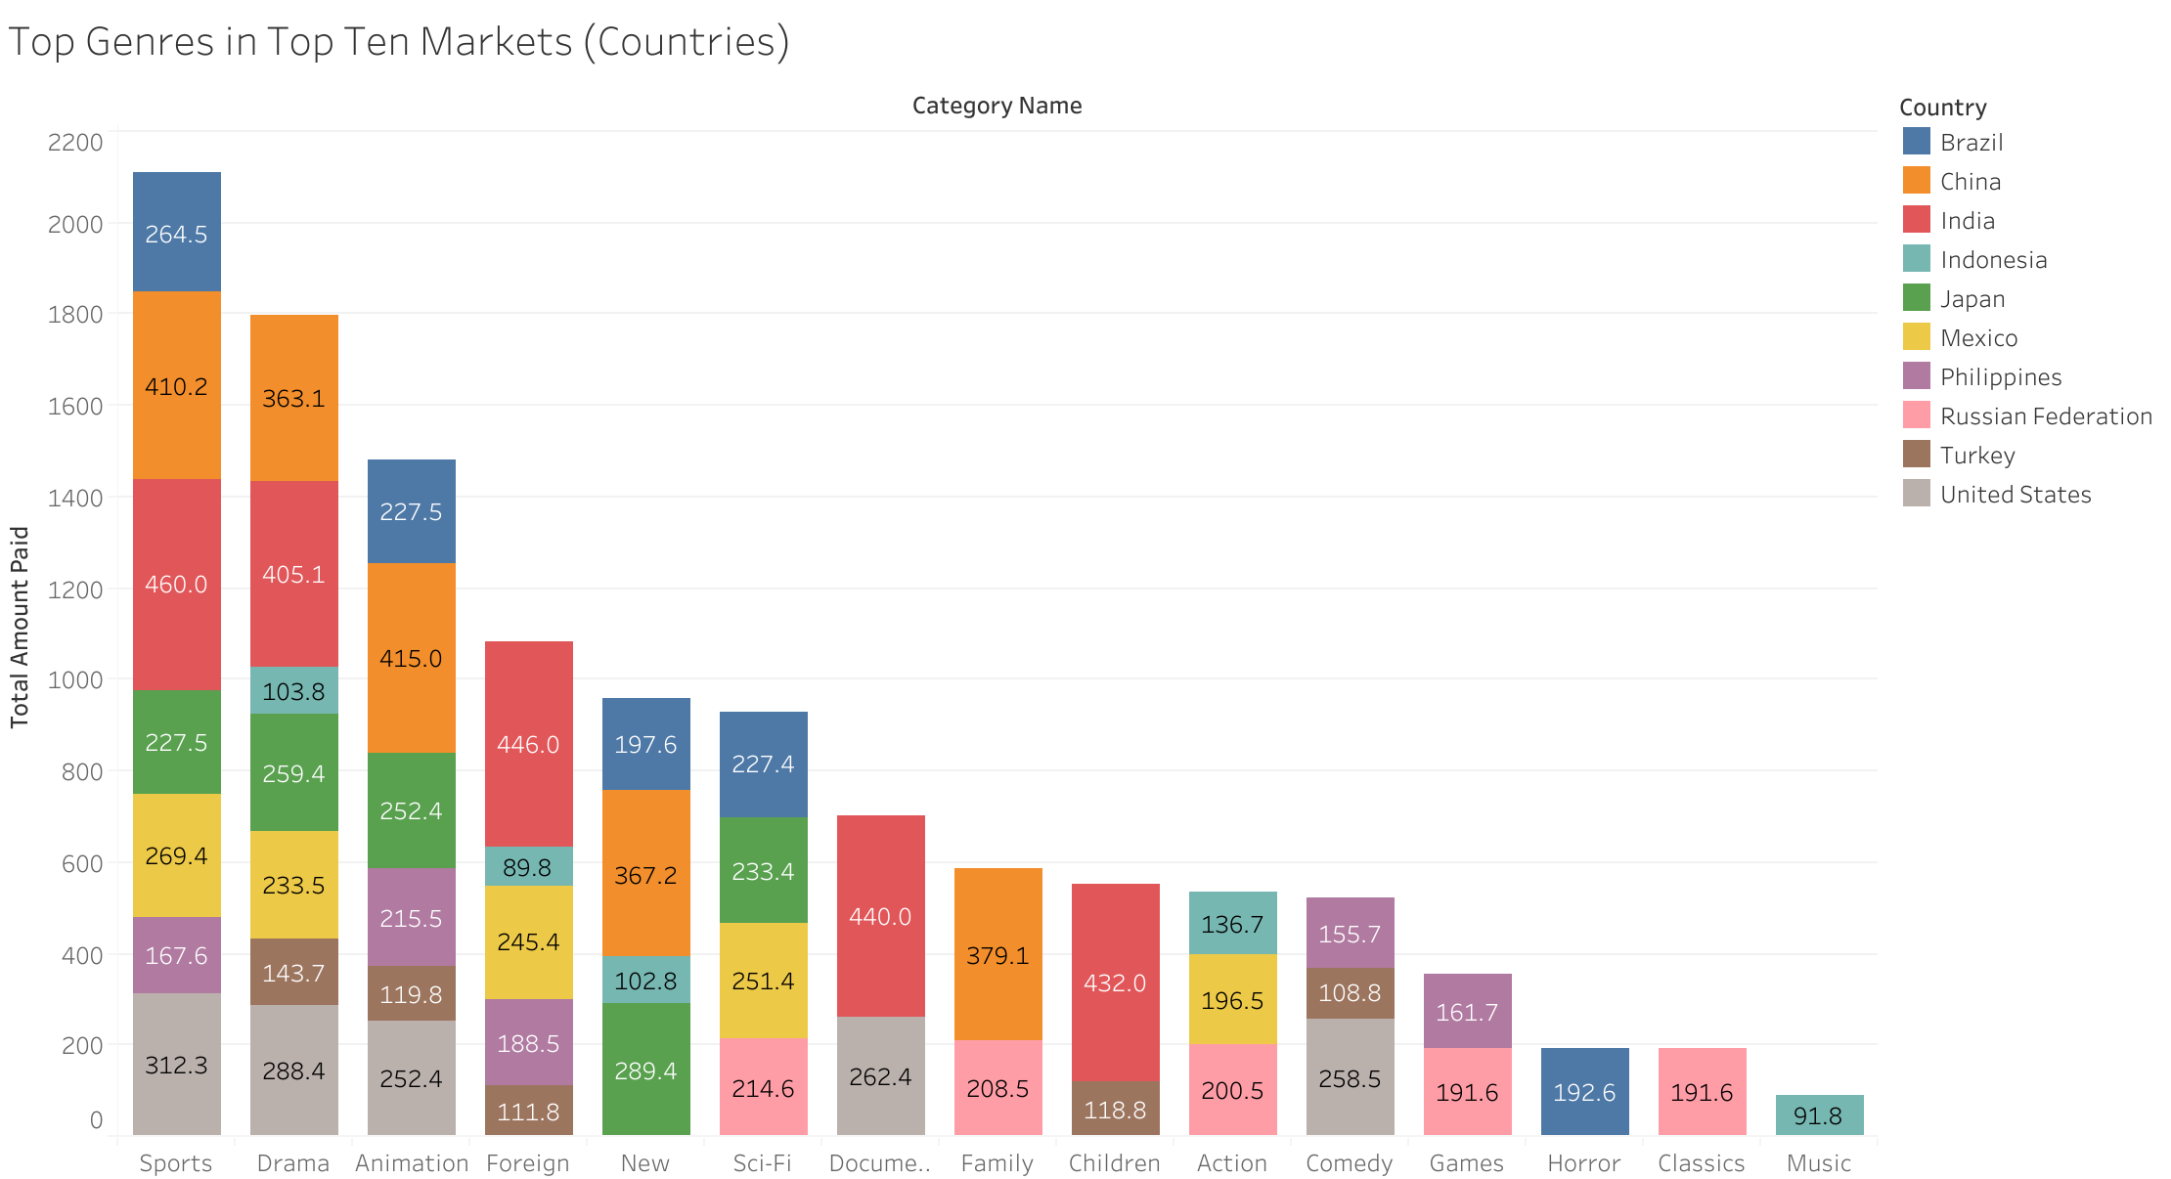
Revenue Per Genre In Top Ten Countries

Slide 17
Top Genres Insights & Recommendations
Key Insights Global popularity of Sports and Animation suggesting universal appeal in these categories.
Different countries prioritize different genres reflecting cultural preferences (ex- India and Turkey emphasize foreign and children genres- reflecting cultural diversity and family-oriented viewing habits. Mexico and Brazil include sci-fi and action indicating interest in more action packed and futuristic content.
Music is unique to Indonesia and horror is unique to Brazil- highlighting regional preference.
Recommendation Use genre/revenue data to create curated collections for each country based on its top genres (ex- For Japan curate collections of sport, animation, sci-fi and drama and for Indonesia create music, action, new and foreign ) instead of having the same film inventory in all countries.

Slide 18
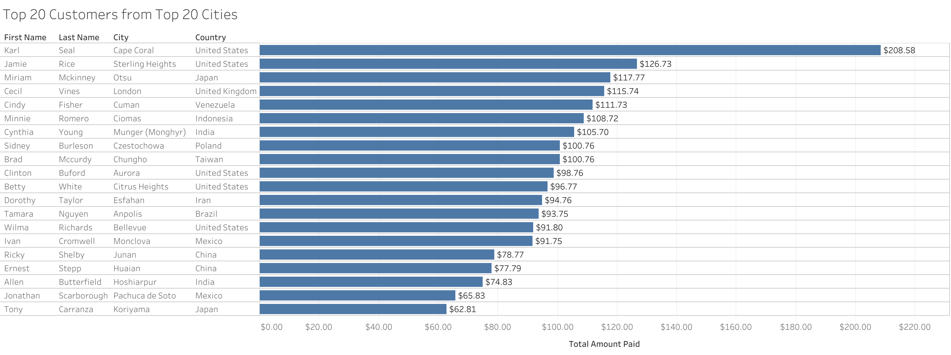
Customer Loyalty
5. Where are customers with a high lifetime value based?
Average amount paid by the top 20 lifetime customers: $101.20
Rockbuster’s high-value lifetime customers are from cities all over the world. 5 out of the top 20 customers come from cities across the US. 2 each from Japan, India, Mexico and China

Slide 19
Launch Strategy Outline For Rockbuster Online Video Streaming Platform
1. Downsize the number of countries Rockbuster provides services in
2. Revise and update current film library
3. Curate country specific collections
4. Develop and launch marketing campaigns
5. Set up analytics and feedback systems
6. Test and soft launch
7. Full launch and promotion

Slide 20
Launch Strategy For Rockbuster Online Video Streaming Platform
1. Downsize the number of countries- Reduce Rockbuster’s global outreach to the top 50 revenue generating countries. This will increase overall profitability by focusing on high value markets, and allows for targeted investment, marketing and resource allocation.
2. Revise and update current film library- Optimize content library by adding titles based on regional preference. Focus on top genres and high performing titles for each country and remove low revenue titles.
3. Curate country specific collections- Create tailored collections for each of the 50 countries incorporating popular genres and trending title.
4. Develop and launch targeted marketing campaigns by regional preferences highlighting localized content and curated collections.
5. Set up analytics and feedback systems- Implement tools to monitor user behavior, technical issues and content performance. Ensure a system is in place for user feedback.
6. Test the platform in select markets to gather real world data. Identify and fix issues based on user feedback.
7.Full launch and promotion- Roll out the video streaming service across all 50 countries with strong localized marketing campaign in each county.

